Slide 1

A Comparative Study of Matrix Factorization and Random Walk with Restart in Recommender Systems
Haekyu Park, Jinhong Jung, and U Kang
Data Mining Lab, Seoul National University
Notes:
Hello, I am Haekyu Park.
I will introduce our paper called “A Comparative …”.

Slide 2
Contents
Introduction
Preliminaries
Recommendation Methods
Experiments
Conclusion
Notes:
Let’s start with the introduction.

Slide 3
Introduction Preliminaries Methods Experiments Conclusion
Research Question
Q1.
Between Matrix Factorization (MF) and Random Walk with Restart (RWR), which method works better for recommendation?
Q2.
Which method handles explicit or implicit feedback data better?
Q3.
Does additional information help recommendation?
Notes:
Let me give you some research questions.
Between Matrix Factorization and Random Walk with Restart, which method works better for recommender system?
Which method handles explicit or implicit feedback data better?
Does additional information help recommendation?
Recommender systems play an important role in many e-commerce services such as Amazon and Netflix to recommend new items to users.
So, why do we compare matrix factorization and random walk with restart in recommender system?

Slide 4
Introduction Preliminaries Methods Experiments Conclusion
Why MF vs RWR?
Collaborative Filtering
Latent factor model
Graph based model
?
?
Matrix Factorization
Random Walk with Restart
Notes:
Collaborative filtering has been successfully adopted among diverse recommendation strategies
due to its high quality performance and domain free property.
The two major approaches of collaborative filtering are latent factor model and graph based model.
Matrix factorization is the most widely used method as a latent factor model.
Random walk with restart is commonly used as a graph based model.
!!!!! However, it is still unclear
which method provides better recommendation quality
despite their extensive utility.
So, we compare MF and RWR.

Slide 5
Contents
Introduction
Preliminaries
Recommendation Methods
Experiments
Conclusion
Notes:
Let’s move on to preliminaries.

Slide 6
Introduction Preliminaries Methods Experiments Conclusion
Preliminaries
Matrix factorization (MF)
How does MF work
The way MF is used in recommendation
Random walk with restart (RWR)
How does RWR work
The way RWR is used in recommendation
Notes:
In this section,
I will explain Matrix factorization and Random walk with restart briefly,
in aspects of the way they are used in recommendation.

Slide 7
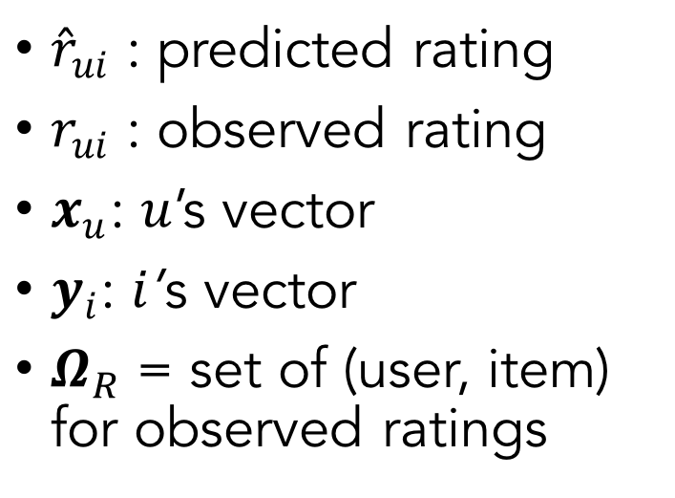
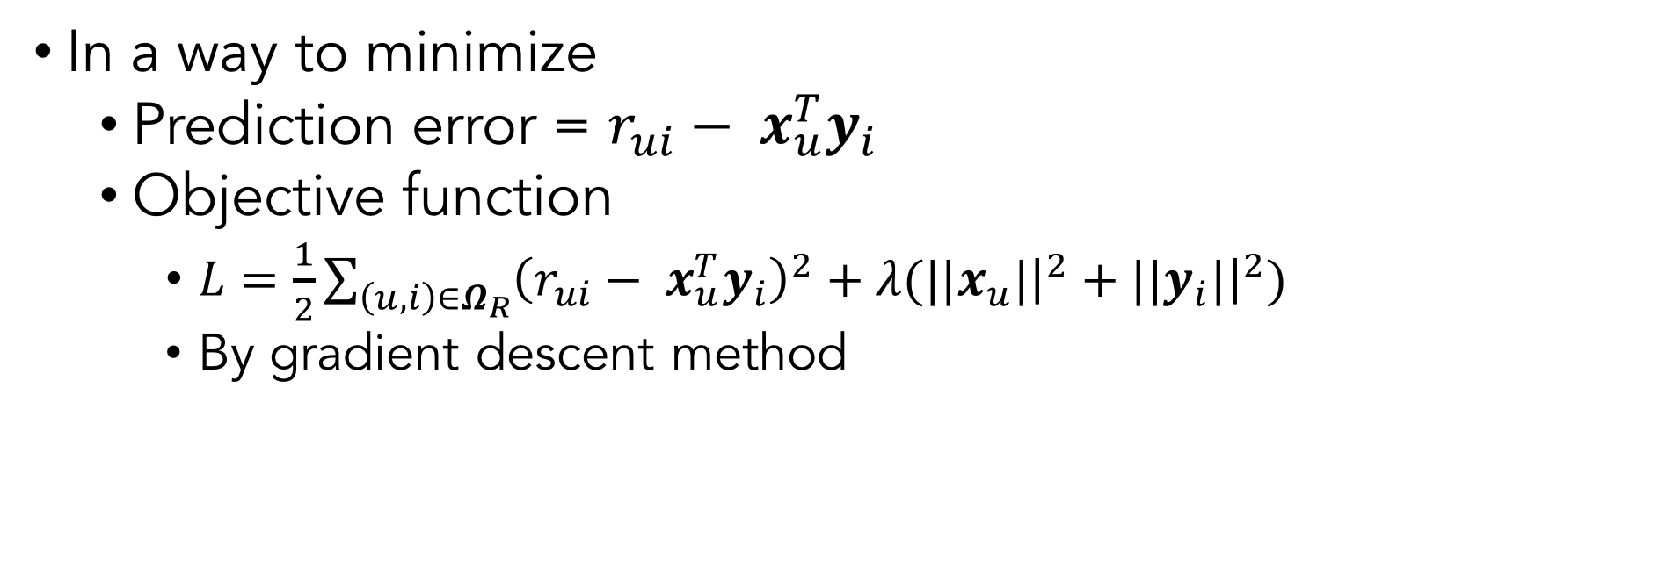
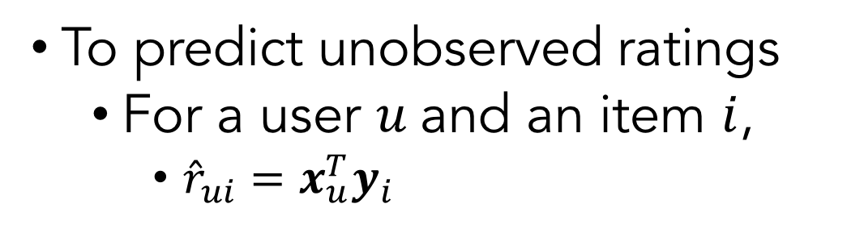
Introduction Preliminaries Methods Experiments Conclusion
Matrix Factorization (MF)
To predict unobserved ratings
For a user $u$and an item $i$,
${\hat{r}}_{ui}=x_{u}^{T}y_{i}$
${\hat{r}}_{ui}$ : predicted rating
$r_{ui}$ : observed rating
$x_{u}$: $u$’s vector
$y_{i}$: $i$’s vector
$Ω_{R}$ = set of (user, item) for observed ratings
In a way to minimize
Prediction error = $r_{ui}− x_{u}^{T}y_{i}$
Objective function
$L=\frac{1}{2}\sum_{\left(u, i\right)∈Ω_{R}}{{\left(r_{ui}− x_{u}^{T}y_{i}\right)}^{2}+λ(||x_{u}|{\left.​\right|}^{2}+||y_{i}|{\left.​\right|}^{2})}$
By gradient descent method
Notes:
Matrix factorization aims to predict unobserved ratings with vectors of users and items.
For a user u and an item I,
the predicted rating of r hat ui is calculated as inner product of x_u and y_i,
where x_u is u' vector and y_i is i's vector.
Matrix factorization aims to minimize prediction error.
It minimizes difference between observed ratings and predicted ratings.
The objective function to minimize is defined as follows.
We use gradient descent method to learn the vectors.

Slide 8
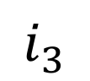

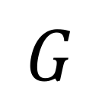

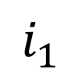
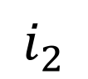
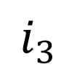

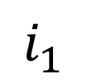
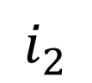
Introduction Preliminaries Methods Experiments Conclusion
Random Walk with Restart (RWR)
$$G$$
Personalized ranking
$$u$$
5
$$i_{1}$$
3
5
:
$$i_{1}$$
$$i_{2}$$
$$i_{3}$$
$$i_{2}$$
$$u$$
$$v$$
4
2
1
$$i_{3}$$
Notes:
Random walk with restart is one of the most commonly used methods
for graph based collaborative filtering.
Given a user-item bipartite graph G
where weight of edges are rating scores
and when a query user u is given,
RWR computes a personalized rankings of items w.r.t the user u.

Slide 9
Introduction Preliminaries Methods Experiments Conclusion
Random Walk with Restart (RWR)
$$G$$
Personalized ranking
$$u$$
5
$$i_{1}$$
3
5
:
$$i_{1}$$
$$i_{2}$$
$$i_{3}$$
$$i_{2}$$
$$u$$
$$v$$
4
2
1
$$i_{3}$$
Notes:
Suppose a random surfer started from the node u.
The surfer walks on the edges,
and it is likely that the surfer moves to a neighbor node linked with higher weight.
Occasionally, the surfer goes back to the starting node u.
The random surfer is likely to frequently visit items,
that are rated highly by users
who give ratings similarly to the query user u.
It is consistent with the intuition of collaborative filtering.
For example,
let's say that the user v has similar taste with the query user u and likes an item i1.
The random surfer will frequently visit v and i1,
because v is similar to u, and i1 is preferred by v.
So, u is likely to prefer i1.

Slide 10
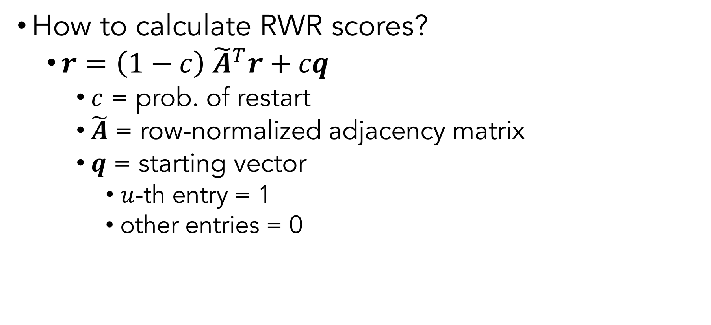
Introduction Preliminaries Methods Experiments Conclusion
Random Walk with Restart (RWR)
How to calculate RWR scores?
$r=\left(1−c\right) {\tilde{A}}^{T}r+cq$
$c$ = prob. of restart
$\tilde{A}$ = row-normalized adjacency matrix
$q$ = starting vector
$u$-th entry = 1
other entries = 0
Notes:
The RWR scores, or preference scores,
are calculated recursively.
The iterative updates are defined as follows.

Slide 11
Contents
Introduction
Preliminaries
Recommendation Methods
Experiments
Conclusion
Notes:
Let’s check our proposed methods
based on matrix factorization and random walk with restart.

Slide 12
Introduction Preliminaries Methods Experiments Conclusion
4 Recommendation scenarios
Explicit feedback
When explicit feedback are given (e.g. 1~5 stars)
Implicit feedback
When implicit feedback are given (e.g. # clicks)
Bias terms
To concern global properties of users and items
Side information
To enhance recommendation performance
To solve cold start problem
Notes:
We present the following recommendation scenarios.
We suggest MF and RWR model for each scenario.
First, we recommend items when explicit feedback ratings are given; for example, movie rating data with 1 to 5 scaled stars are given.
Second, we present recommendation methods for implicit feedback data such as the number of clicks on items.
Third, we use bias terms indicating global properties of users and items in our recommendation methods.
For the last, we present recommendation methods that use additional information to enhance recommendation performance and to solve cold start problem.

Slide 13
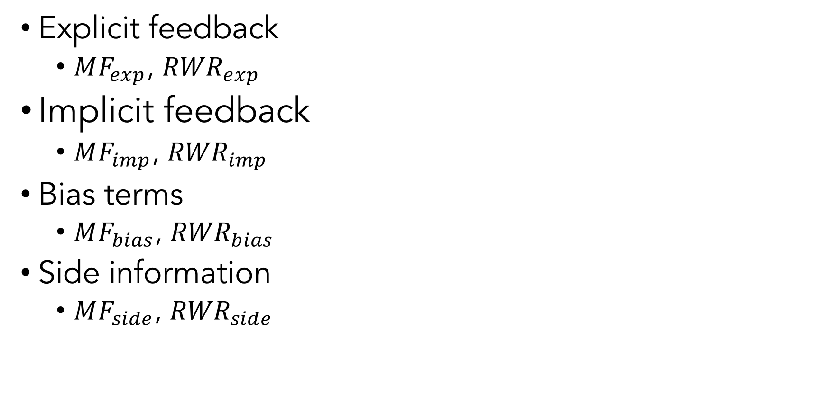
Introduction Preliminaries Methods Experiments Conclusion
4 MF and 4 RWR
Explicit feedback
$MF_{exp}$, ${RWR}_{exp}$
Implicit feedback
$MF_{imp}$, ${RWR}_{imp}$
Bias terms
$MF_{bias}$, ${RWR}_{bias}$
Side information
$MF_{side}$, ${RWR}_{side}$
Notes:
We call the 4 MF and 4 RWR methods as follows.

Slide 14
Introduction Preliminaries Methods Experiments Conclusion
4 scenarios
Explicit feedback
Implicit feedback
Bias terms
Side information
Explained in the preliminaries
Notes:
First, when explicit feedback are given,
we use the same models explained in the preliminaries.

Slide 15
Introduction Preliminaries Methods Experiments Conclusion
4 scenarios
Explicit feedback
Implicit feedback
Bias terms
Side information
Notes:
Next, I will present MF and RWR model for implicit feedback.

Slide 16
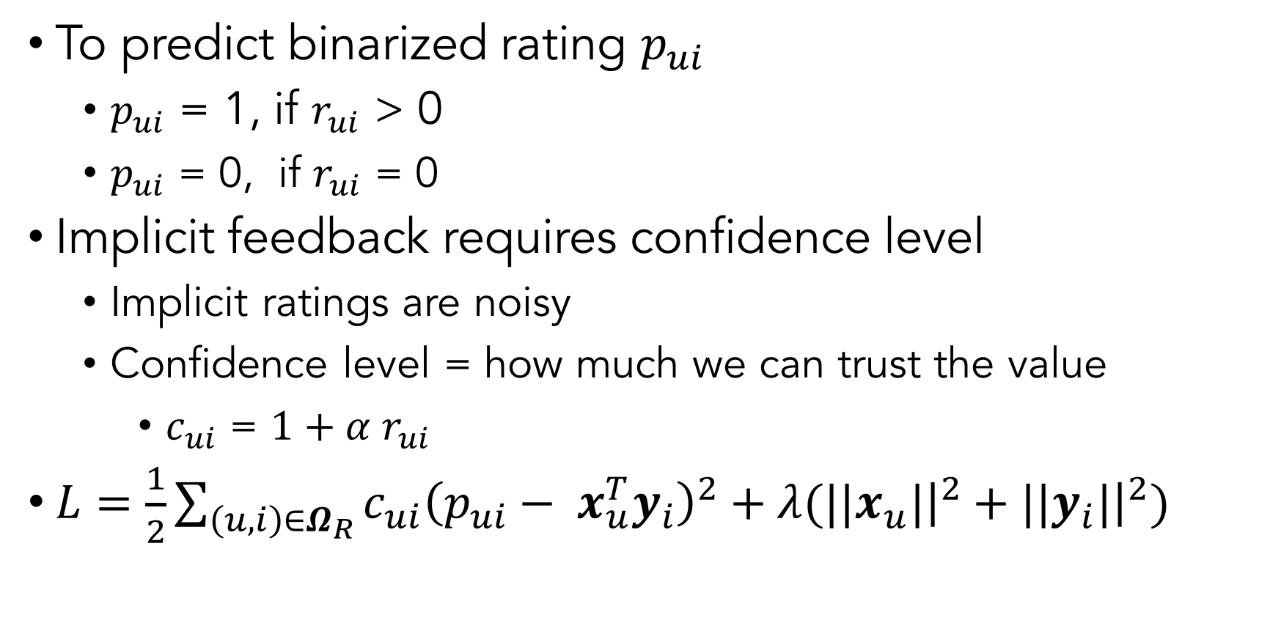
Introduction Preliminaries Methods Experiments Conclusion
4 scenarios
$MF_{imp}$: MF for implicit feedback
Explicit feedback
Implicit feedback
Bias terms
Side information
To predict binarized rating $p_{ui}$
$p_{ui}$ = 1, if $r_{ui}$ > 0
$p_{ui}$ = 0, if $r_{ui}$ = 0
Implicit feedback requires confidence level
Implicit ratings are noisy
Confidence level = how much we can trust the value
$c_{ui}$ = $1+α r_{ui}$
$L=\frac{1}{2}\sum_{\left(u, i\right)∈Ω_{R}}{{c_{ui}\left(p_{ui}− x_{u}^{T}y_{i}\right)}^{2}+λ(||x_{u}|{\left.​\right|}^{2}+||y_{i}|{\left.​\right|}^{2})}$
Notes:
MF_implicit predicts binarized rating p_ui.
P_ui is defined as 1 when rating r_ui is higher than 0.
P_ui is defined as 0 when the observed rating is 0.
MF_implicit requires confidence level of each rating r_ui,
since implicit data are inherently noisy.
For example, not watching a movie sometimes indicates dislike for the movie
or ignorance of its existence.
The confidence level crystallizes how certainly we can use the rating value.
We define the confidence value for r_ui as 1 + alpha r_ui.
The objective function of MF_implicit is defined as follows.

Slide 17
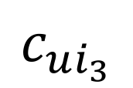

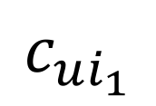
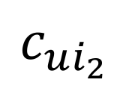



Introduction Preliminaries Methods Experiments Conclusion
4 scenarios
${RWR}_{imp}$: RWR for implicit feedback
Explicit feedback
Implicit feedback
Bias terms
Side information
$$i_{3}$$
$$c_{ui_{3}}$$
$$u$$
Set weight of edges with confidence level
$$c_{ui_{2}}$$
$$c_{ui_{1}}$$
$$i_{1}$$
$$i_{2}$$
Calculate RWR scores
Notes:
Next, I will explain RWR_implicit.
When implicit data are given,
We build the graph G by setting weight of edges with the confidence level.
Then, we calculate RWR scores as explained in the preliminaries.

Slide 18
Introduction Preliminaries Methods Experiments Conclusion
4 scenarios
Explicit feedback
Implicit feedback
Bias terms
Side information
Notes:
Next, I will describe MF and RWR models which use bias terms.

Slide 19
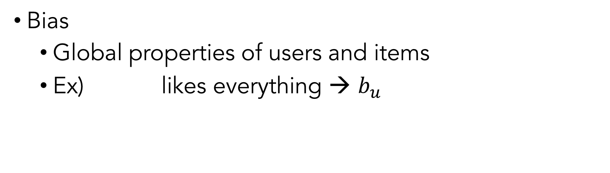
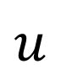
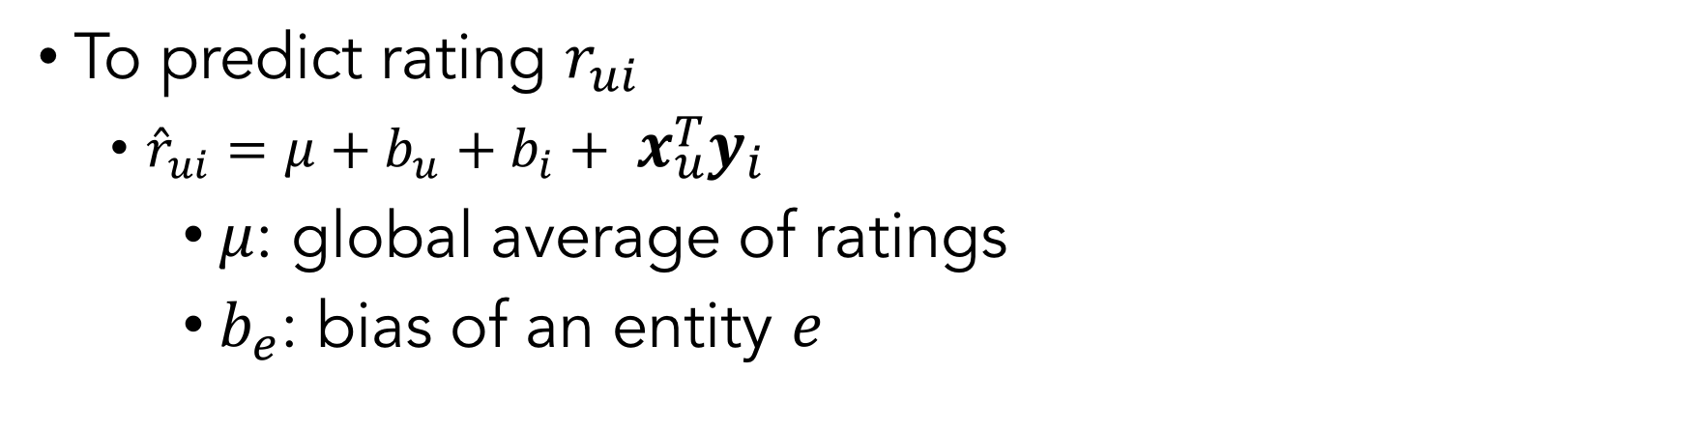
Introduction Preliminaries Methods Experiments Conclusion
$MF_{bias}$: MF employing global bias terms
4 scenarios
Bias
Global properties of users and items
Ex) likes everything → $b_{u}$
Explicit feedback
Implicit feedback
Bias terms
Side information
$$u$$
To predict rating $r_{ui}$
${\hat{r}}_{ui}=μ+b_{u}+b_{i}+ x_{u}^{T}y_{i}$
$μ$: global average of ratings
$b_{e}$: bias of an entity $e$
Notes:
MF_bias introduces bias temrs into MF_explicit to represent individual rating pattern of users and items.
For example, if a user u normally likes every items,
u’s bias term b_u is learned to possess high value.
MF_bias predicts rating
with global average ratings, bias factors,
and inner product of x_u and y_i.

Slide 20
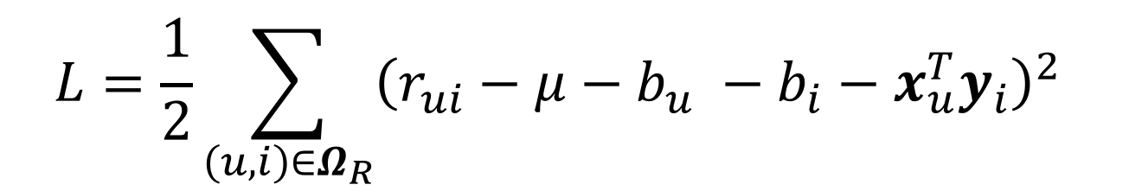
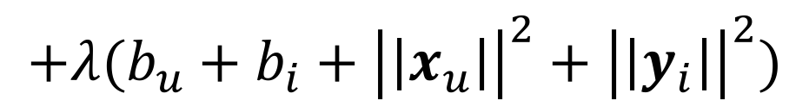
Introduction Preliminaries Methods Experiments Conclusion
$MF_{bias}$: MF employing global bias terms
4 scenarios
Objective function to minimize:
Explicit feedback
Implicit feedback
Bias terms
Side information
$$L=\frac{1}{2}\sum_{\left(u, i\right)∈Ω_{R}}{{\left(r_{ui}−μ−b_{u} −b_{i}−x_{u}^{T}y_{i}\right)}^{2}}$$
$$+λ(b_{u}+b_{i}+{\left|\left|x_{u}\right|\right|}^{2}+{\left|\left|y_{i}\right|\right|}^{2})$$
Notes:
The objective function of MF_bias is given as follows.

Slide 21
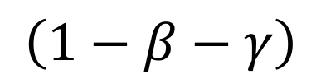
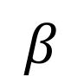
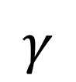
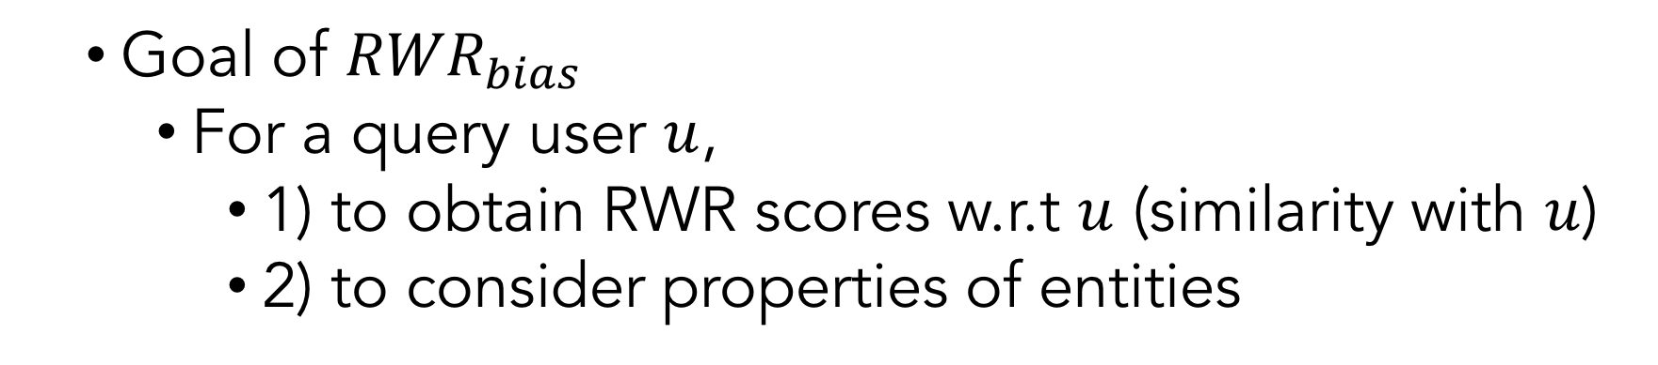
Introduction Preliminaries Methods Experiments Conclusion
${RWR}_{bias}$: RWR employing global bias terms
Goal of ${RWR}_{bias}$
For a query user $u$,
1) to obtain RWR scores w.r.t $u$ (similarity with $u$)
2) to consider properties of entities
4 scenarios
Explicit feedback
Implicit feedback
Bias terms
Side information
$$γ$$
$r= b+ { \tilde{A}}^{T}r+ q$
$$\left(1−β−γ\right)$$
$$β$$
2) Global nature
1) Similarity score
Notes:
How about RWR_bias?
For a query user u, the goals of RWR_bias are as follows.
First, it obtains RWR scores w.r.t to u,
which indicates similarity with u.
Second, it considers global properties of users and items in RWR scores.
The first goal of calculating similarity score is done by the basic RWR approach.
The second goal to increase RWR scores
of generally popular items or users
is done by the bias terms.

Slide 22
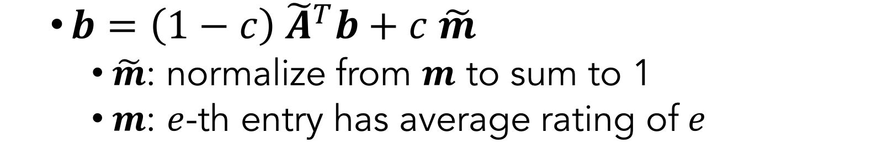
Introduction Preliminaries Methods Experiments Conclusion
${RWR}_{bias}$: RWR employing global bias terms
Calculate bias vector $b$
$b=\left(1−c\right){ \tilde{A}}^{T}b+c \tilde{m}$
$\tilde{m}$: normalize from $m$ to sum to 1
$m$: $e$-th entry has average rating of$e$
4 scenarios
Explicit feedback
Implicit feedback
Bias terms
Side information
Notes:
Before we compute RWR vector,
we first compute the bias vector b as follows.
The bias vector b consists of the random walk term as (1 – c) A tilda tanspose b,
and a jump term as c m tilda.
M tilda is aimed to increase RWR scores of popular nodes
by assigning higher probabilities that a random surfer jumps to the popular entities.
M tilda is normalized to sum to 1 from a non-normalized vector m.
For each entity e, e-th entry value in m is the global average rating value of e.

Slide 23
Introduction Preliminaries Methods Experiments Conclusion
4 scenarios
Explicit feedback
Implicit feedback
Bias terms
Side information
Notes:
Finally, we present MF and RWR method to use side information.

Slide 24
Introduction Preliminaries Methods Experiments Conclusion
$MF_{side}$: MF using side information
4 scenarios
Coupled Matrix Factorization
To use latent information of side data for the user / item vectors
Ratings and side information are represented by the same feature (They share the vectors)
Explicit feedback
Implicit feedback
Bias terms
Side information
Notes:
User similarity information such as friendship in social network
or item similarity information such as items’ category
are advantageous for finding user with similar tastes and items with similar properties,
which causes latent vectors of users and items to be similar.
For MF to use side information, we use coupled matrix factorization approach.

Slide 25
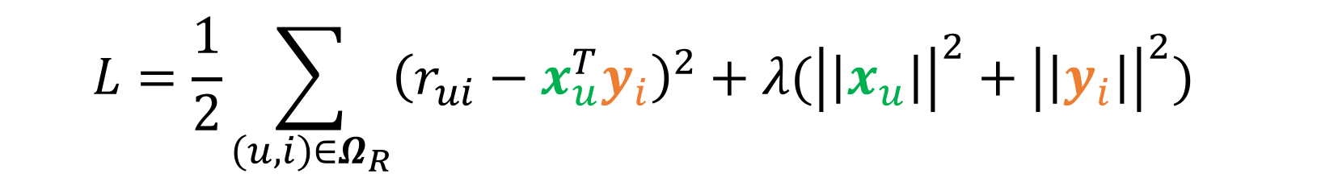
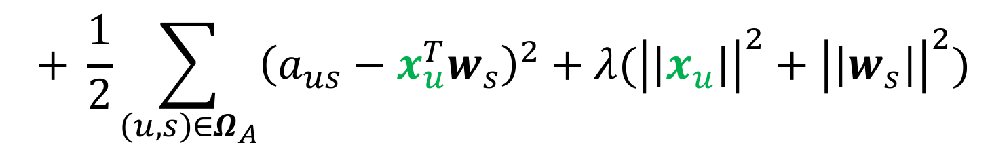
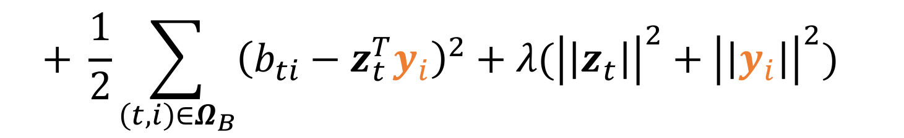
Introduction Preliminaries Methods Experiments Conclusion
4 scenarios
$MF_{side}$: MF using side information
Explicit feedback
Implicit feedback
Bias terms
Side information
Factorization of ratings
$$L=\frac{1}{2}\sum_{\left(u, i\right)∈Ω_{R}}{{\left(r_{ui}−x_{u}^{T}y_{i}\right)}^{2}}+λ({\left|\left|x_{u}\right|\right|}^{2}+{\left|\left|y_{i}\right|\right|}^{2})$$
Factorization of user similarity attributes
$$+ \frac{1}{2}\sum_{\left(u, s\right)∈Ω_{A}}{{\left(a_{us}−x_{u}^{T}w_{s}\right)}^{2}}+λ({\left|\left|x_{u}\right|\right|}^{2}+{\left|\left|w_{s}\right|\right|}^{2})$$
Factorization of item similarity attributes
$$+ \frac{1}{2}\sum_{\left(t,i\right)∈Ω_{B}}{{\left(b_{ti}−z_{t}^{T}y_{i}\right)}^{2}}+λ({\left|\left|z_{t}\right|\right|}^{2}+{\left|\left|y_{i}\right|\right|}^{2})$$
Notes:
The objective function of MF_side is defined as follows.
Omega R is a set of (user, item) where ratings are observed.
Omega A is a set of (user, and user attribute) where the user similarity attributes such as age are observed.
Omega B is a set of (item attribute, and item) where the item similarity attributes such as genre are observed.
For a user u and a user similarity attribute s,
a_us indicates u’s properties on s such as u’s age.
For an item i and an item similarity attribute t,
b_ti is i’s attribute value with respect to t.

Slide 26



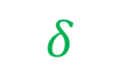

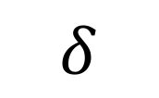

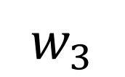

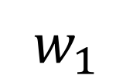
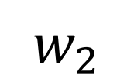

Introduction Preliminaries Methods Experiments Conclusion
${RWR}_{side}$: RWR using side information
$$i_{3}$$
$$w_{3}$$
4 scenarios
$$δ$$
Explicit feedback
Implicit feedback
Bias terms
Side information
$$u$$
$$w_{2}$$
$$w_{1}$$
$$δ$$
$$i_{2}$$
$$Romance$$
$$i_{1}$$
$$i_{1}$$
Add new edges whose weights are
$$i_{1}$$
Calculate RWR scores
$$δ$$
Notes:
How about RWR for side information?
Suppose we have genre information of movies.
We add genre node such as Romance into the graph G,
and connect romance movies to the genre.
RWR_side computes RWR scores on the augmented graph.

Slide 27
Contents
Introduction
Preliminaries
Recommendation Methods
Experiments
Conclusion
Notes:
Let’s check our experiments and results.

Slide 28
Introduction Preliminaries Methods Experiments Conclusion
Experiment questions for 4 scenarios
Explicit rating
Q1: Which method performs better with explicit data?
Implicit rating
Q2: Which method performs better with implicit data?
Bias terms
Q3: Do the bias terms enhance performance?
Side information
Q4: Do side data enhance performance?
Notes:
We focus on the following questions according to the major tasks.
We conducted seven types of experiments for the scenarios,
but we show only 4 representative experiments in this presentation.
Question 1. Which ~
Question 2. ~

Slide 29
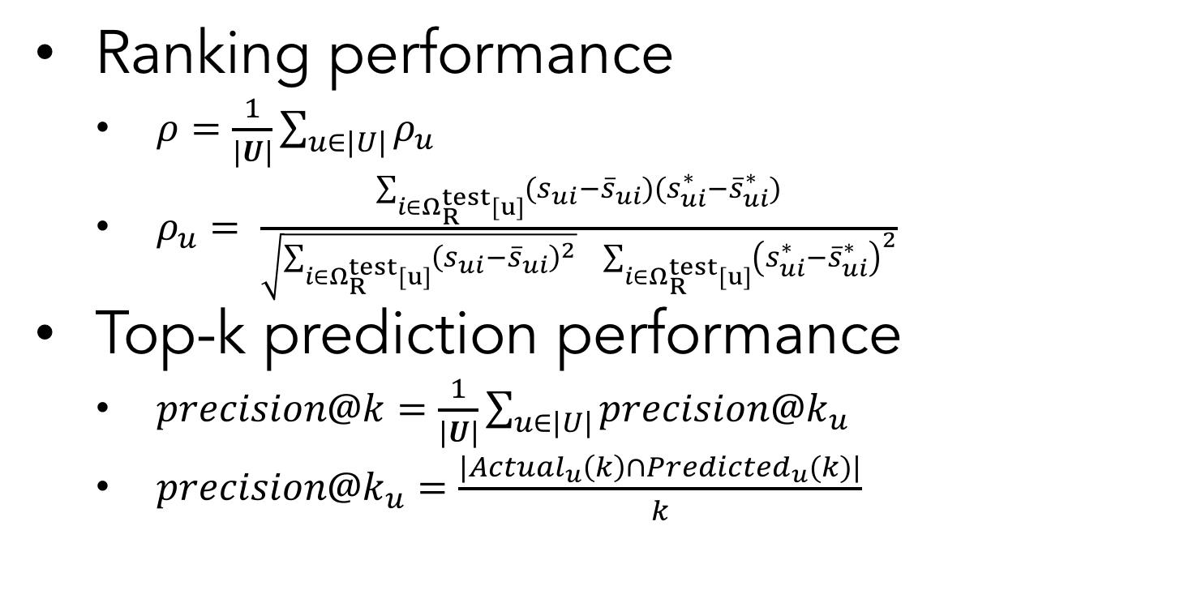
Introduction Preliminaries Methods Experiments Conclusion
Metric
Ranking performance
$ρ=\frac{1}{|U|}\sum_{u∈|U|}{ρ_{u}}$
$ρ_{u}= \frac{\sum_{i∈Ω_{R}^{test}[u]}{(s_{ui}−{\overline{s}}_{ui})(s_{ui}^{∗}−{\overline{s}}_{ui}^{∗})}}{\sqrt{\sum_{i∈Ω_{R}^{test}[u]}{{\left(s_{ui}−{\overline{s}}_{ui}\right)}^{2}}} \sum_{i∈Ω_{R}^{test}[u]}{{\left(s_{ui}^{∗}−{\overline{s}}_{ui}^{∗}\right)}^{2}}}$
Top-k prediction performance
$precision@k=\frac{1}{|U|}\sum_{u∈|U|}{{precision@k}_{u}}$
$precision@k_{u}=\frac{|Actual_{u}\left(k\right)∩Predicted_{u}(k)|}{k}$
Notes:
We employ two measures to compare performance of MF and RWR.
We measure global ranking and top-k prediction performance.
We use Spearman’s rho for ranking performance
and precision@k for top-k prediction performace.

Slide 30
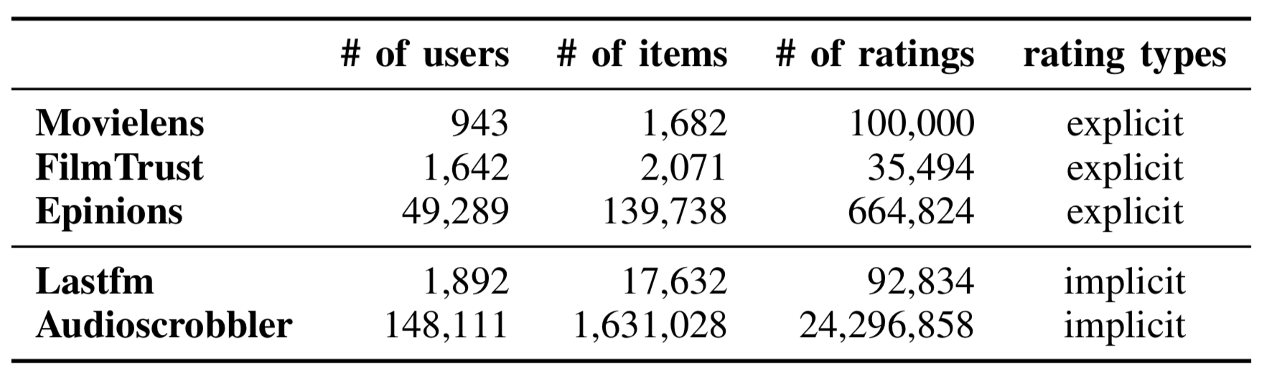
Introduction Preliminaries Methods Experiments Conclusion
Datasets
Notes:
We use the following five real world datasets.
We have 3 explicit and 2 implicit datasets.
They also have side information such as users’ age or gender.
In this presentation, we only show you the experiments using Movielens and Lastfm.

Slide 31
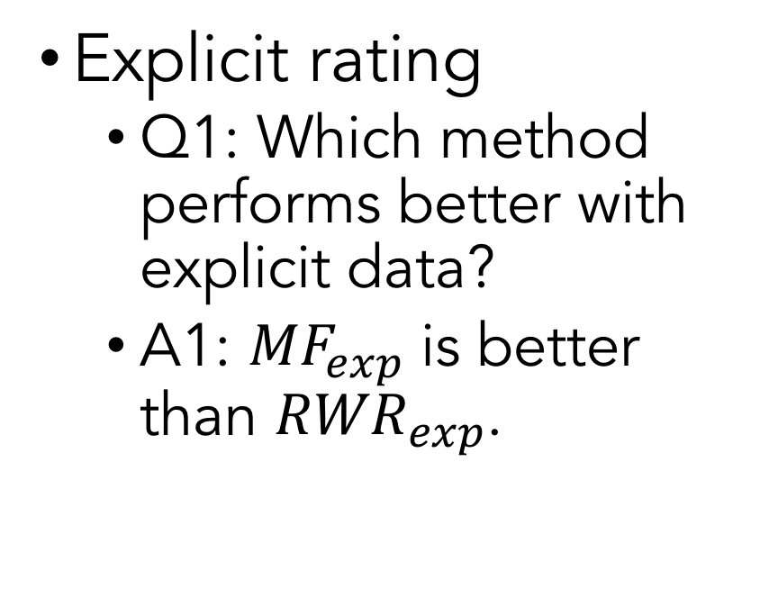
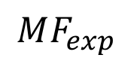
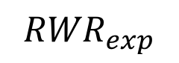
Introduction Preliminaries Methods Experiments Conclusion
Experiment results
Best
Explicit rating
Q1: Which method performs better with explicit data?
A1: ${MF}_{exp}$ is better than ${RWR}_{exp}$.
$$MF_{exp}$$
$${RWR}_{exp}$$
Notes:
Which method performs better with explicit data?
We discovered that MF shows better performance than RWR,
in global ranking performance and top-k prediction performance.
You can see that blue MF is btetter than the orange RWR.

Slide 32
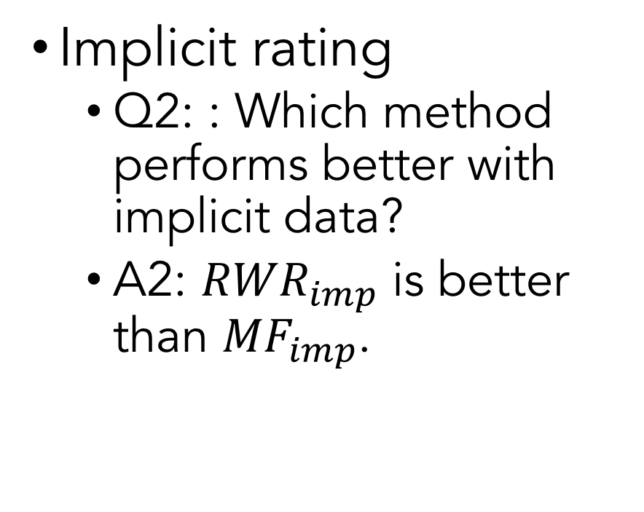
Introduction Preliminaries Methods Experiments Conclusion
Experiment results
Best
Implicit rating
Q2: : Which method performs better with implicit data?
A2: ${RWR}_{imp}$ is better than ${MF}_{imp}$.
Ranking
Top 1, 2, 3 prediction
$$MF_{exp}$$
$${RWR}_{exp}$$
Notes:
Which method performs better with implicit data?
We discovered that RWR shows better performance than MF,
in global ranking performance and top-k prediction performance.
You can see that the blue MF is worse than the orange RWR.

Slide 33
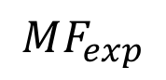
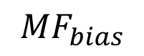
Introduction Preliminaries Methods Experiments Conclusion
Experiment results
Best
Bias terms
Q3: Do global bias terms improve performance?
A3: Yes
Ranking
Top 1, 2, 3 prediction
$$MF_{exp}$$
$${MF}_{bias}$$
Notes:
How about methods employing bias terms?
Do the bias terms improve performance?
The answer was yes, in both MF and RWR.
We only show you the result of MF
but RWR presents the similar results.

Slide 34
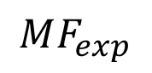
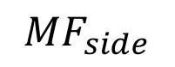
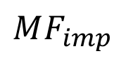
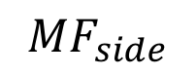
Introduction Preliminaries Methods Experiments Conclusion
Experiment results
Best
Explicit data
Side information
Q4: Do side data enhance performance?
A4: Yes (explicit ratings), No (implicit ratings)
$$MF_{exp}$$
$${MF}_{side}$$
Ranking
Top 1, 2, 3 prediction
Best
Implicit data
$$MF_{imp}$$
$${MF}_{side}$$
Ranking
Top 1, 2, 3 prediction
Notes:
Next, do side data enhance performance?
Our answer is,
Yes with explicit ratings
and No with implicit ratings.
The upper plot shows the result with explicit data.
You can see that MF improves when additional data are used.
The bottom plot shows the result with implicit data.
You can see that MF degrades when additional data are used.
RWR shows similar pattern, and it is described in our paper.
So, please read our paper to see more details.

Slide 35
Introduction Preliminaries Methods Experiments Conclusion
Experiment Summary
MF performs better with explicit ratings.
RWR performs better with implicit ratings.
Explicit feedback
RWR
MF
Implicit feedback
Explicit feedback
Implicit feedback
Side info improves performance with explicit feedback.
Side info degrades performance with implicit feedback.
Age
Gender
Occupation
Age
Gender
Occupation
Good
Bad
Notes:
We found out some interesting observations from the experiments.
MF performs better with explicit ratings than implicit ratings.
RWR performs better with implicit ratings than explicit ratings.
Side ~
Side ~

Slide 36

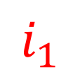

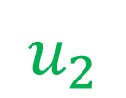
Introduction Preliminaries Methods Experiments Conclusion
Discussion – why?
RWR is influenced by proximity of nodes.
However, explicit scores occasionally contradict the proximity.
Explicit feedback
MF
RWR
Our expectation
Implicit feedback
$$i_{1}$$
$$u$$
$$u_{2}$$
$$i_{2}$$
Notes:
So, why is that?
Let me first explain the first observation.
Why RWR fits well with implicit feedback, and does not fit well with explicit feedback?
RWR is influenced by proximity of nodes, or the number of hops.
However, explicit scores occasionally contradict the proximity of nodes.
For example, suppose that a query user u is given, and the u does not like i1.
The user u2 is a user whose taste is similar to that of user u.
u2 likes i2.
So, we expect that RWR scores w.r.t u are as follows:
i1 has lower RWR scores,
and i2 has high RWR scores.

Slide 37
Introduction Preliminaries Methods Experiments Conclusion
Discussion – why?
RWR is influenced by proximity of nodes.
However, explicit scores occasionally contradict the proximity.
Explicit feedback
MF
RWR
But, RWR results
Implicit feedback
$$i_{1}$$
$$u$$
$$u_{2}$$
$$i_{2}$$
Notes:
However, RWR gives a higher RWR score on a 1-hop negative item
such as the red item i1 that the user u dislikes.
And, RWR gives lower score on a 3-hop positive items
such as the green item i2 that is preferred by u2 who has similar taste with u.

Slide 38
Introduction Preliminaries Methods Experiments Conclusion
Discussion – why?
Explicit feedback
Implicit feedback
Why side info does not fit well with implicit data?
Side info : noisy
Implicit : noisy
Age
Gender
Occupation
Age
Gender
Occupation
Good
Bad
Further noise
Notes:
Additional information is used well with explicit feedback
But not with implicit ones.
Our conjecture is that side information is noisy,
and the noise further debases the quality of information in implicit feedback data
which are also noisy.

Slide 39
Contents
Introduction
Preliminaries
Recommendation Methods
Experiments
Conclusion

Slide 40
Introduction Preliminaries Methods Experiments Conclusion
We provide a comparative study of matrix factorization (MF) and random walk with restart (RWR) in recommender system.
We suggest four tasks according to various recommendation scenarios.
We observe that MF and RWR behave differently according to whether input ratings are explicit or implicit.
We also observed that side information improves recommendation quality with explicit ratings, while degrades it with implicit feedback.

Slide 41
Thank you!
Contact: Haekyu Park (hkpark627@snu.ac.kr / http://haekyu.com)

